Slide 1
NHSScotland Capital Investment Network
2 May 2017
Mike Baxter
Director of Finance, Corporate and Analytical Services
Transport Scotland

Slide 2
Lessons from another Portfolio
Transport Scotland
Our Capital Programme
The basics
Repeat business – capacity and capability
A longer term look
Learning Lessons
What did I take from health to transport

Slide 3
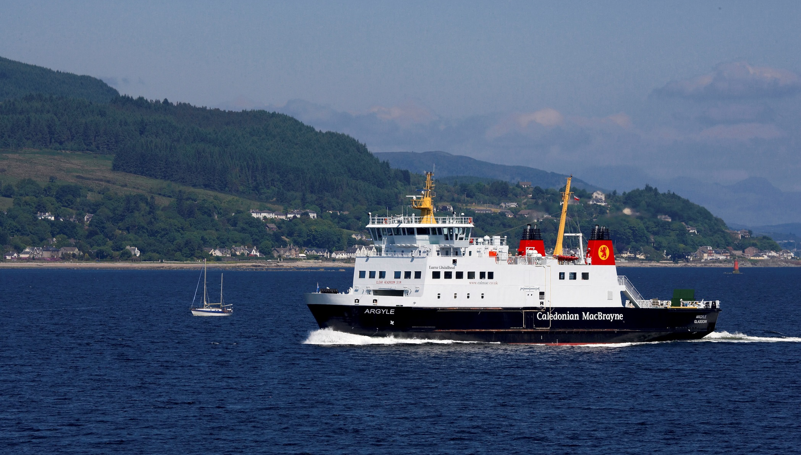

Slide 4
Transport Scotland
Transport Scotland is an executive agency of the Scottish Government accountable to the Scottish Parliament through the Scottish Ministers. It is part of the Scottish Administration for the purposes of Part II of the Scotland Act 1998.
Responsible for: rail and trunk road networks; passenger rail services; major public transport projects; national concessionary travel schemes; impartial travel information services; coordinating National Transport Strategy for Scotland; liaising with regional transport partnerships; sustainable transport, road safety and accessibility; local roads policy; aviation, bus, freight and taxi policy; ferries, ports, harbours and canals; and Blue Badge Scheme.

Slide 5
£18.6m
Air
TRANSPORT SCOTLAND BUDGET 2017-18
£254.4m
NCTS and Bus
£193.4m
Ferry
£748m
Rail
Total budget
2016/17:
£2.3bn
£270.8m
Other projects
and agency
administration
£823.3m
Motorways and
Trunk Roads

Slide 6

Forth Rail Bridge
Notes:
Recent successes
Forth Rail Bridge – UNESCO site
Recent successes
Franchises
Performance management over winter period 16/17
Gleneagles station award winning legacy
Edinburgh Gateway opened December 2016
EGIP project electrifying route between edinburgh and glasgow
New rolling stock bought and coming into service in 2018/19

Slide 7
Our Capital Programme
Roads and Motorways – new build and maintenance
Ferries
Aviation
Canals
Rail Infrastructure – maintenance/ renewals and improvements
Circa £1 billion per annum

Slide 8
The Basics
Capacity and capability
Effective physical and financial planning
Robust appraisal and evaluation
National Transport Strategy
Strategic Transport Projects Review
Procurement and commercial experience
Infrastructure is a means to an end
Visibility and transparency

Slide 9
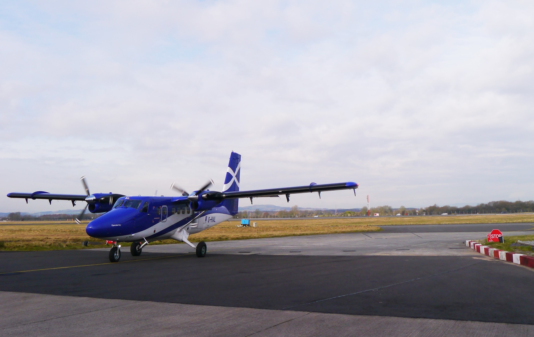
Notes:
Recent successes
Two new aircraft procured for HIAL routes
At least 5 new air routes to America, Middle east and Canada supporting freight/businesses and tourism

Slide 10
Repeat business
It’s what we do
Pipeline of activity – specialists
Use of consultants
Development of our own capacity
Contractual and commercial arrangements

Slide 11

Rail Franchise
Notes:
TS manage two rail franchises [Abellio ScotRail & Serco Caledonian Sleeper]
£475M invested in rolling stock within the ScotRail fleet in the next three years
23% increase in seating capacity to be provided from mid 2019
All fleets to be fully PRM-TSI compliant ahead of the January 2020 deadline
70 new Hitachi C385 trains to be introduced from autumn 2017 onwards across the central belt
26 fully refurbished High Speed Trains (HST)s rolled out onto inter-city routes from summer 2018
75 new sleeper carriages to be introduced from spring 2018 on overnight services to/from London

Slide 12
A longer term look
Asset planning well developed
Risk based approach
Long term financial planning well established
Long lead in times for major projects
How does our pipeline drive/ influence procurement strategy and market capacity
Political and financial commitment

Slide 13

Forth Replacement Crossing
Notes:
The Queensferry Crossing is forecast to open to traffic between mid-July and the end of August depending on weather conditions. The Bridge Contractors advised that a May opening date is no longer achievable, citing delay and disruption caused by the weather (particularly wind) beyond that which was foreseen by them in June 2016 as the primary source of this delay. This however hasn’t stopped the contractor making every effort to open this iconic structure at the earliest opportunity – without compromising safety.
Progress is very visible - with the removal of the tower cranes and false work (trestles underneath the decking) currently occupying the top spot. The North Tower crane has been fully removed and the other two huge cranes are on their way down. The removal of the cranes and false work is highlighting to all, the slenderness of the Queensferry Crossing towers.
The huge expansion joints have been installed and the final deck concrete pours are taking place this week on the South Approach Viaduct – weather permitting.

Slide 14
Learning Lessons
Easier within a single organisation
Cohesive approach to programme management
Significant investment programme gives opportunities – wider impact of investment, workforce, learning and development, STEM
Analysis and evaluation of projects

Slide 15
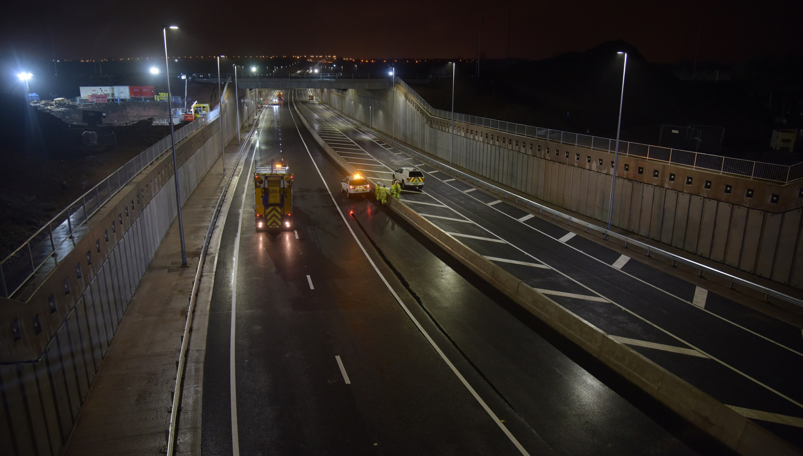
M8 M73 M74 Motorway Improvements Project
Notes:
**M8 eastbound opening Sunday 30th April**
Recent Successes
M8 M73 M74 Motorway Improvements Project - £500m. Due to open to traffic Spring 2017
The new Raith Underpass at J5 of the M74 has opened to traffic marking a major milestone on the £500 million M8 M73 M74 Motorway Improvements Project.
The M8 M73 M74 Motorway Improvements project currently employs approximately 1200 people.
It is also anticipated the project will provide a minimum of 30 graduate and apprenticeship positions during the three year construction period, with a further 20 construction jobs each year aimed specifically at long term unemployed people.
The project is also expected to provide sustainable long-term employment opportunities for approximately 60 full-time staff during the operation and maintenance of these key routes over a 30 year period.
Job centres to be notified of site-based employment opportunities;
Contracts with subcontractors and suppliers not already allocated shall be advertised through Public Contracts Scotland procurement website; and
A ‘Skills Pledge’ to develop the skills and qualifications of its workforce, supply chain and local community has been signed by the contractors on the M8 M73 M74 Motorway Improvements and AWPR/B-T projects.

Slide 16
What did I take from Health to Transport
Ability to drive improvement
Structured approach to maintenance – breaking down the backlog
Co-ordination across SG and wider public sector
The value of effective core processes
The value of good people

Slide 17

Any Questions?
Photo Credit: Iain Ferguson
Notes:
Raith at night

